Slide 1


Introduction to Storage Area Network (SAN) Solutions
Storage Area Networks (SAN) are critical for large enterprises. They provide high-speed connectivity to storage resources. This creates a consolidated storage environment that enhances efficiency and performance.

Slide 2
Assessing Enterprise Storage Requirements
Data Growth
Access Frequency
Compliance Needs
Understanding current and future data growth is essential. It impacts overall storage capacity needs.
Classify data by access frequency—hot, warm, or cold. This helps in effective tiering strategies.
Identify industry-specific compliance requirements. These may dictate certain storage methods or protocols.

Slide 3
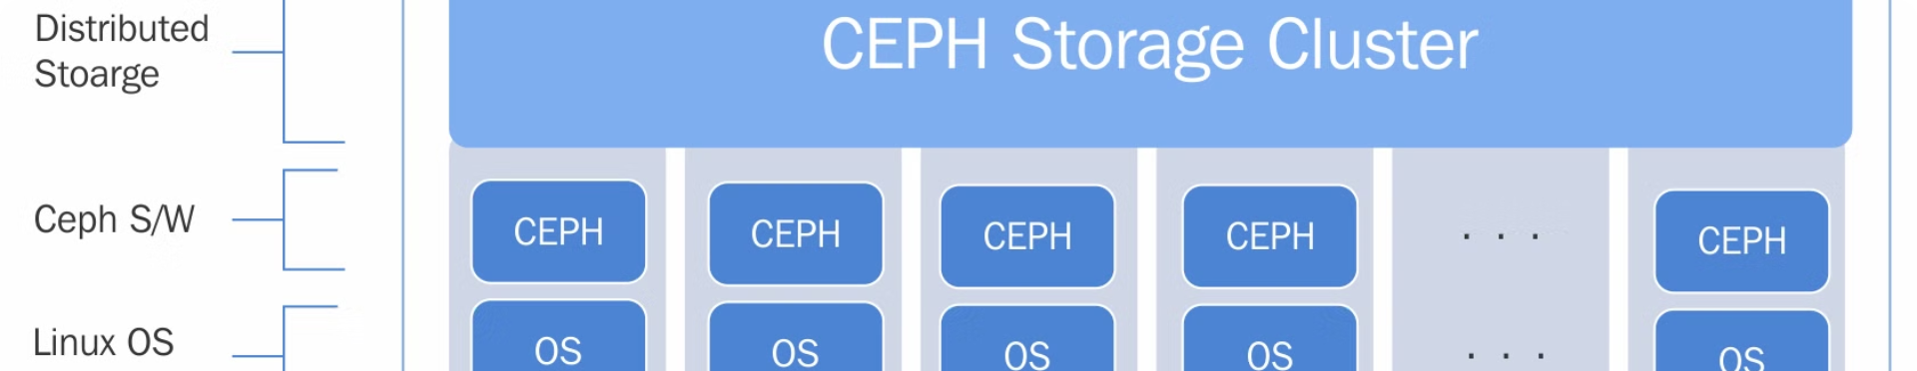
Scalability Considerations for the SAN
1
2
3
Initial Setup
Expansion Plans
Flexible Architecture
Design for future growth right from the beginning.
Include modular components that allow for easy additions later.
Ensure the architecture supports various storage technologies and protocols.

Slide 4

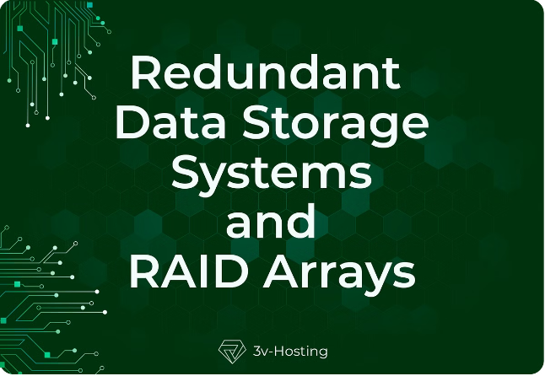
High Availability and Fault Tolerance
1
Redundancy
2
Load Balancing
Implement redundant hardware components to prevent single points of failure.
Use load balancers to distribute workloads across multiple paths.
3
Automatic Failover
Incorporate automatic failover mechanisms to enhance uptime.

Slide 5


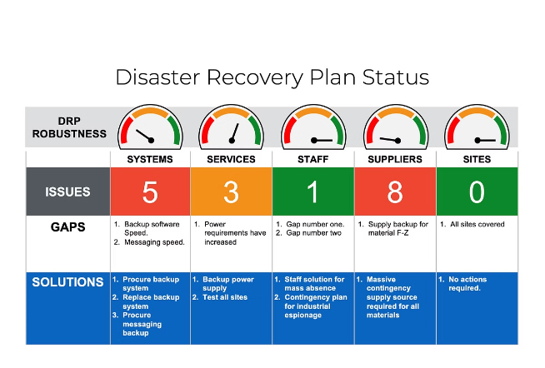


Disaster Recovery Planning
Regular Backups
Schedule regular backups for all critical data.
Offsite Storage
Store backups in an offsite location to ensure safety.
Testing Procedures
Regularly test your disaster recovery plan.

Slide 6


Performance Optimization Strategies
Strategy
Description
Caching
Use caching to speed up data access.
Data Tiering
Automatically move data to appropriate tiers as needed.
Parallel Processing
Implement parallel processing to enhance performance.

Slide 7

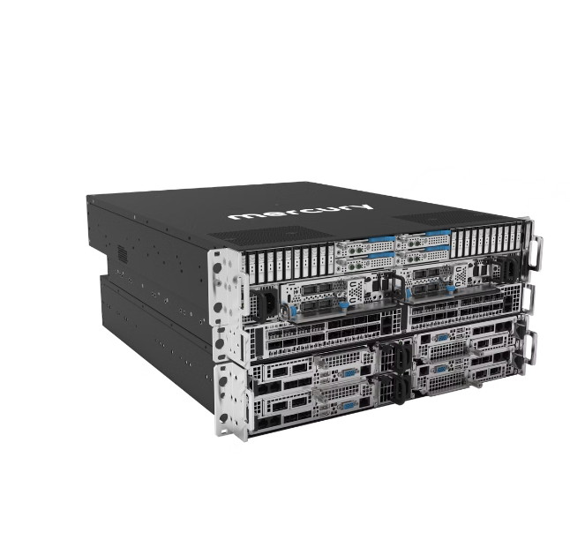
Cost-Effective SAN Design
Open Standards
Virtualization
Utilize open standards to avoid vendor lock-in and reduce costs.
Leverage storage virtualization to maximize resource utilization.
Tiered Storage
Implement tiered storage to optimize costs based on performance needs.

Slide 8

Conclusion and Recommendations:
Implementing a well-designed SAN solution is crucial for large enterprises. Focus on scalability, performance, and recovery strategies. Prioritize cost-effectiveness to maximize ROI on storage investments.

